Slide 1
Classroom Management system
For CSYE6200 – Wednesday's class

Slide 2
Team members.
Anirudh Vijayaraghavan - 002885983
Rushikesh Deore
Sunil Srinivaas
Mayur Kenkre
Manish Kandukuri
Soeb

Slide 3
Introduction.
Our application provides a simple solution to classroom organization and management based on age and student to teacher ratio.
Add Teachers :
First name, Last name, Teacher ID, Date of Birth, E-mail.
View Teachers
Add Students :
First name, Last name, Student ID, Date of Birth, Address, Phone no., Guardian Name, E-mail, Vaccination dates
View Students, and fetch details of the selected students from the storage.

Slide 4
About the app.
Our app lets you input the student and teacher details, either through a CSV file, or through the application itself, whichever convenient.
The details entered through the application get stored in the backend file.
Functionalities to check all students and teachers currently enrolled, are present.
The app on reloading the program then sorts the classrooms based on student to teacher ratio, as per the requirement.
As an added functionality, on enrollment, we receive the immunization details from the students as well. We are able to check the immunization records of any student we select, which returns information such as booster doses / required doses being overdue, etc.

Slide 5
Packages and Libraries used.
Packages :
Java.util.*
Javax.swing
Java.util.Calendar
Java.awt
JAR Files :
"activation.jar"
"additionnal.jar"
"javax.mail.jar"
"jgoodies-common-1.8.0.jar"
"jgoodies-forms-1.8.0.jar"
"mail.jar"

Slide 6
Design Features.
Inheritance by extending abstract person for common parameters.
Factory pattern while creating Vaccine/disease categorization.
CSV implementation- file reading and writing.
Runnable interface implementation.
Thread usage.
Filter and stream API- anonymous class.
Swing UI.

Slide 7
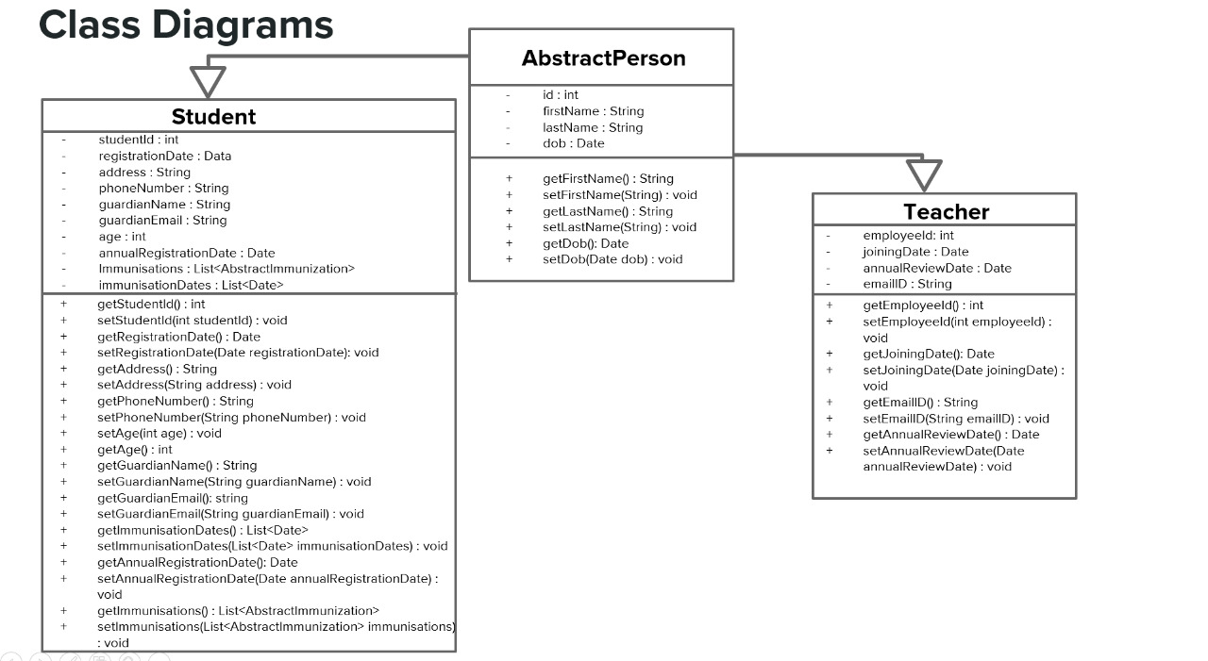
UML Diagram 1.

Slide 8
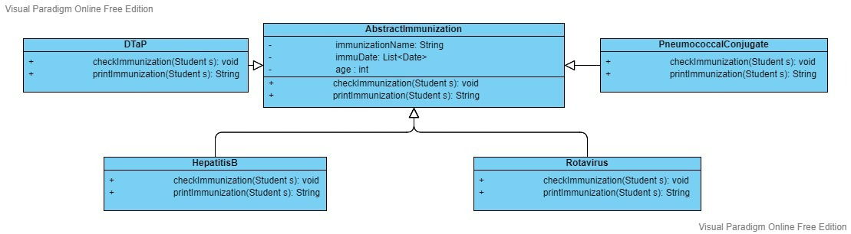
UML Diagram 2.

Slide 9
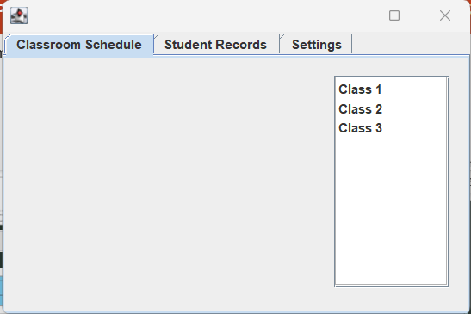
Screenshots
Initial screen on startup.
Consists of classes preloaded based
On the values present .csv files.

Slide 10
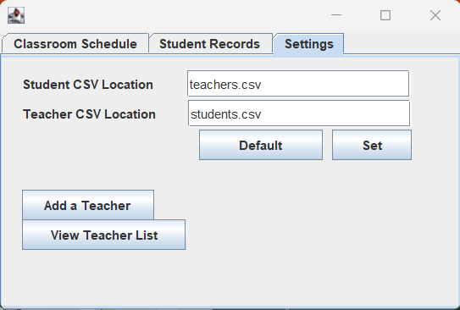
Screenshots
This is the screen where we can add
Teachers to the teachers.csv list.
2 main buttons are Add a teacher and
View teacher list (explained in the next
Slide).

Slide 11
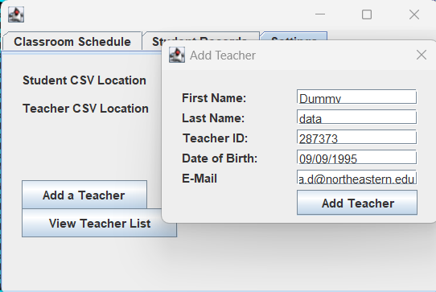
Screenshots
All fields mandatory.
On clicking the Add teacher,
The teachers.csv file gets appended
With the latest details.

Slide 12
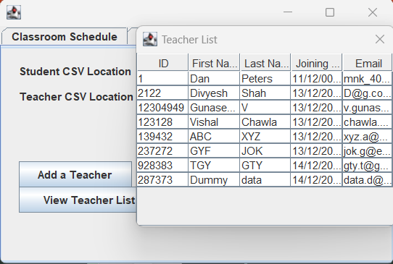
Screenshots
On comparing with the
Teachers.csv file, we can see that
All values are present.

Slide 13
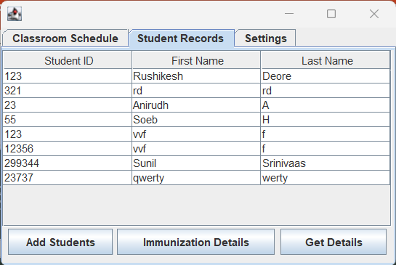
Screenshots
This is the screen where we can add
Students to the students.csv list.
3 main buttons are Add students,
Get details, and immunization details.

Slide 14
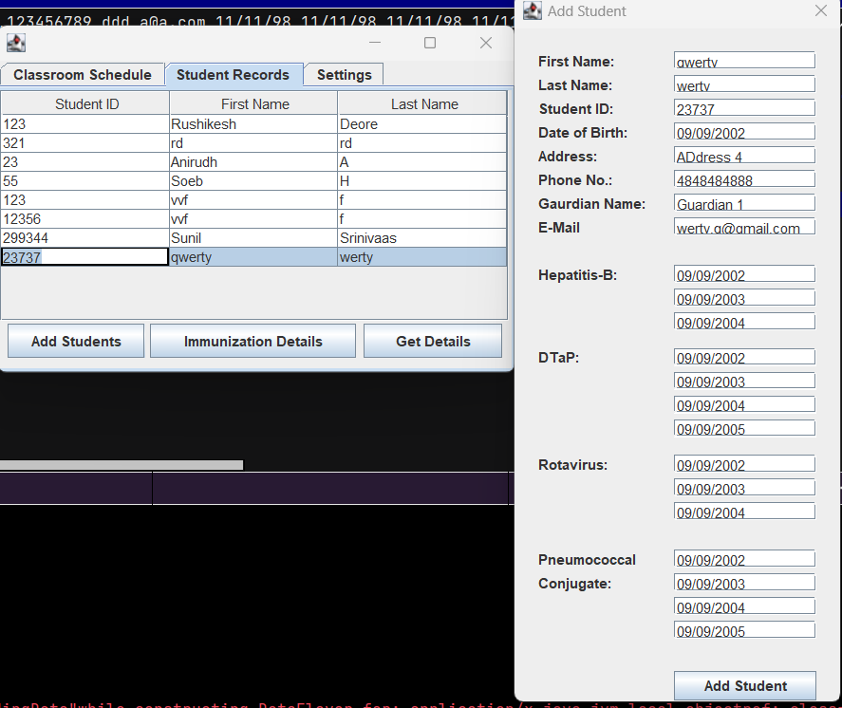
Screenshots
Most fields mandatory.
Validations present for some fields
Such as date. On clicking Add Student
, data gets appended to students.csv

Slide 15
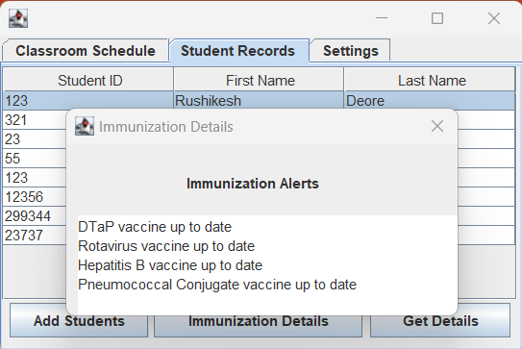
Screenshots
Immunization details for every
Student can be selected.
The result strings are returned
based on the date values inputted in the add
Student window.
The results are calculated based on
Birth date and number of shots per
Vaccine taken.

Slide 16
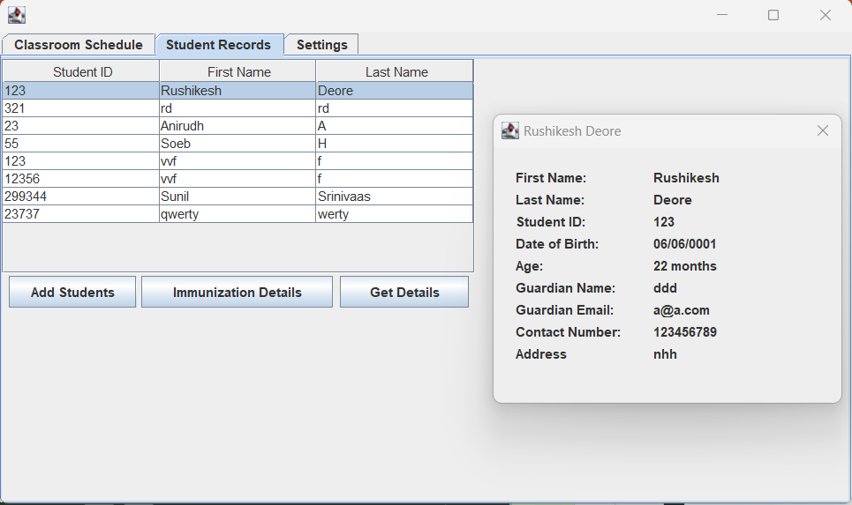
Screenshots
Get details button
fetches data for a student
Selected in the table.

Slide 17
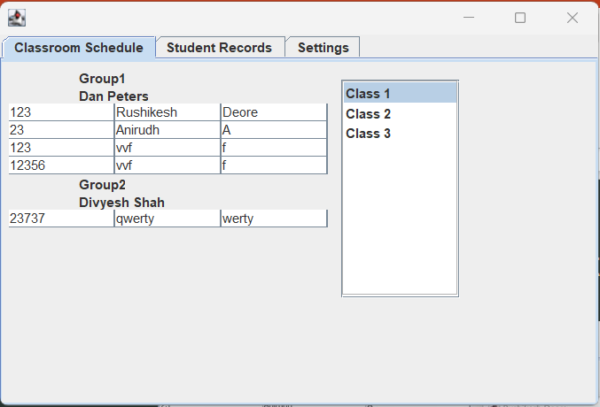
Screenshots
Classroom schedule will be refreshed
On reloading the app.
This window will show the classes
Segregated based on age and groups
Segregated based on student to teacher
Ratio.
Eg : Class 1 is for students aged 6 – 12.
Post filtering students aged 6-12, they are
Split into 4:1 student to teacher ratio for the available
Teachers.

Slide 18
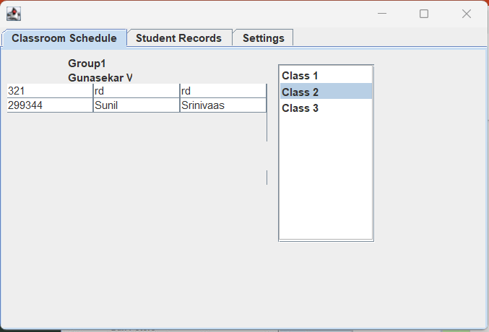
Screenshots
Classroom schedule will be refreshed
On reloading the app.
This window will show the classes
Segregated based on age and groups
Segregated based on student to teacher
Ratio.
Eg : Class 2 is for students aged 13 – 24.
Post filtering students aged 13 – 24, they are
Split into 5:1 student to teacher ratio for the available students
And Teachers.

Slide 19
Future scope.
This application which assists with sorting / organization can be extended to patients to doctors, small businesses to handle workflow.
We can add functionality to send periodic reminders through mails / sms to get overdue immunizations.
Data mining / Analytics to check who has received vaccinations, and who hasn’t.

Slide 20
Contributions.
Mayur Kenkre, Rushikesh Deore, Anirudh Vijayaraghavan – Backend, Design of classes.
Sunil Srinivaas, Soeb, Manish Kandukuri – Swing implementation, UI design, UML diagram logic.
Group efforts for PPt, and video.

